Slide 1
ILLINOIS FITNESS ALLIANCE
Addressing Mitigation:
How Illinois can permit group exercise classes and operate them safely across the state

Slide 2
The Illinois Fitness Alliance has two asks
Lift the restriction on classes to keep predominantly women-owned businesses open, keep our predominantly female staff employed, and provide a physical and mental outlet that will help Illinoisans survive COVID, and this winter, safely.
Use the 25% of fire code capacity for fitness classes and 6’ social distancing to dictate capacity limit and require masks everywhere at all times. Relying on masks and social distancing has been very successful in Chicago since June.
We appreciate your time and welcome your questions.

Slide 3
Boutique studios are a major driver of the Fitness Industry and classes are critical to their survival. The current class suspension is equivalent to a shutdown.
Boutique studios represent a big section of the fitness industry
In 2015, boutique studios accounted for 42% of the U.S. Health Club Market, doubling from 2014. The boutique sector has continued massive growth since.
Boutique fitness in Chicago is a $500 million industry that provides more than 25,000 jobs with 1,000,000 unique people visiting our facilities per year.
Classes are critical for boutique studios to survive
80 – 95% of revenue comes from membership and repeat class pack purchases.
Without membership revenue, studios are bleeding from the fixed costs of rent, utilities, etc.
For many studios, “open gym” is not as feasible model as an instructor is needed to help participants understand what to do (true for yoga, Pilates, barre, etc)
Studios lost 30% – 60% of membership revenue upon reopening after the first shutdown.
Many studios have closed and more permanent closures will result if the class suspension continues.
Women are most impacted by suspended classes and studio closures
The majority of boutique studio owners are female (>60% of IFA studio owners and 65% of Boutique Fitness Summit owner attendees).
The majority of class instructors, studio managers, and front desk staff are female – these employees are suffering their 2nd furloughs and are uncertain about their employment future.
The majority of participants in group classes are female – Many are moms who are dealing with the impacts of COVID on their work, schools, and children’s mental health and wellbeing.
This class is often their only mental health hour of the day and they NEED this time to stay healthy to keep their families going.
Illinois is one of only 4 states prohibiting group exercise; masks and 6’ distancing work.
Continuing the suspension of classes will have major economic and employment consequences, particularly on women who own, staff, and attend boutique studios.

Slide 4
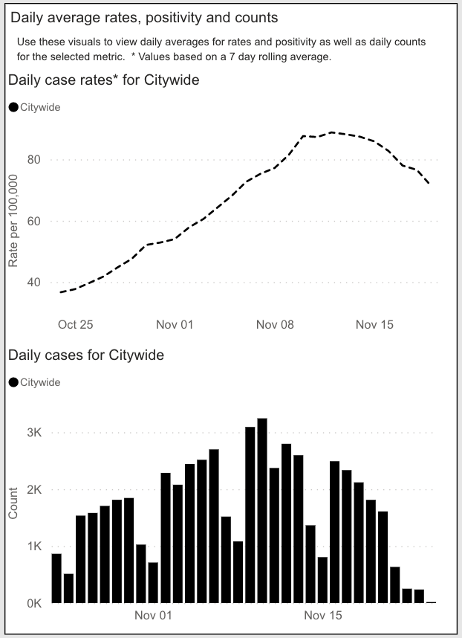
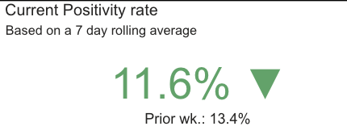
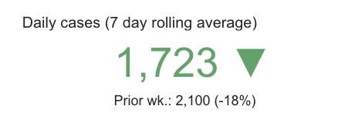
Chicago data shows that suspending classes was NOT necessary for lowering case counts and positivity rates
In early November case and positivity rates were escalating in Chicago, peaking at 16% on Nov. 12
On Nov 12, the City added restrictions that did NOT suspend classes
Nov 12
Case and positivity rates decreased substantially while letting classes continue
Data from 11/30/20 before effect of class suspension would have been registered

Slide 5
Given no evidence of COVID spread from Fitness, we appreciate that gyms are open during Tier 3 Mitigations. Classes provide even more control and should be allowed.
Fitness ventilation standards are 2.7-4x that of other industries
HVAC Ventilation Per Chicago Code | Fitness Centers | Office | Places of Worship | Retail | Restaurants | Bars
Ft³/ min/ person* | 20 | 5 | 5 | 7.5 | 7.5 | 7.5
Monitoring and contact tracing are inherent capabilities of bus. model
Fitness centers control access and can enforce appropriate behavior among members, including not allowing entry if they have symptoms or don’t follow rules.
Cleaning is monitored and directed.
Fitness centers have contact information and know the date and time of each member visit.
Contact tracing data indicates that COVID is NOT spreading at fitness facilities
Louisiana: Only 1.5% of cases from a “non-congregate setting” originated from Fitness. Colorado: Only 2 of 2,529 documented outbreaks occurred in Fitness settings.
New York: Health clubs have been the source for 0.06% of cases. Given this finding, Gov Cuomo has loosened restrictions on the Fitness industry in NY.
Illinois: Health clubs/ studios account for 1.3% of outbreaks (232 of 17,939 total cases).
PLUS: Class instructors control physical distancing and mask compliance
Classes are always socially distanced – instructors assign individual stations and direct movement.
With limited capacity, equipment is even more spaced than usual.
An instructor can ensure that participants are wearing masks correctly at ALL times, not just upon entry and exit.
Classes create an additional layer of control and offer an extremely controlled and safe environment for people to stay physically and mentally healthy.

Slide 6
Fitness centers are part of the solution to addressing COVID-fatigue and reducing negative COVID-19 outcomes
Issue
Resolution
COVID is exacerbating mental health issues
U.S. adults have reported considerably elevated adverse mental health conditions associated with COVID-19⁴
CDC found 11% of Americans had suicidal thoughts (v. 4.3% in ‘18)
The psychological and physical benefits of exercise can help improve mood and reduce anxiety^{1,3}
Many people feel isolated
COVID-fatigue is setting in – people want to be active and social
In home gathering are the worst case response to that need
Studios provide safe places for people to get out and be active.
Classes offer community and safe socialization
UK Chief Medical Officer (Chris Witty) in responding to a COVID-19 question, said “There is no situation, no age, no condition where exercise is not a good thing.”
Winter is coming
For those who have been active outside, the onset of winter reduces those opportunities
Health clubs are staff supervised, safe places to continue physical activity
People who are “in shape” have better COVID outcomes
According to the NIH, most patients with severe COVID-19 cases had at least one comorbidity: obesity, hypertension, and diabetes
Regular exercise improves cardiovascular health, blood pressure, body weight, and protects against a variety of diseases and improves vaccine repsonse^{2,5}
NIH study - Comorbidity and its Impact on Patients with COVID-19 - https://www.ncbi.nlm.nih.gov/pmc/articles/PMC7314621/
Harvard Medical School Article - How to boost your immune system - https://www.health.harvard.edu/staying-healthy/how-to-boost-your-immune-system
Mayo Clinic - Depression and anxiety: Exercise eases symptoms - https://www.mayoclinic.org/diseases-conditions/depression/in-depth/depression-and-exercise/art-20046495
CDC - Morbidity and Mortality Weekly Report, August 14, 2020 - https://www.cdc.gov/mmwr/volumes/69/wr/mm6932a1.htm
NIH study - Effects of exercise on vaccine-induced immune responses - www.ncbi.nlm.nih.gov/pmc/articles/PMC3903912/

Slide 7
CHARTS AND DATA: Louisiana Contact Tracing Data indicates that fitness centers are not where the spread of COVID is happening
Louisiana has 50% occupancy and recommends masks but does not strictly require them
Louisiana Outbreak Setting* | # of outbreaks | % of total | Cases | % of total
Food Processing | 38 | 6.4% | 918 | 21.9%
Industrial Setting | 89 | 15.0% | 627 | 15.0%
Bar | 50 | 8.4% | 537 | 12.8%
Religious Services/Event | 69 | 11.6% | 335 | 8.0%
Restaurant | 75 | 12.6% | 300 | 7.2%
Other Worksite | 50 | 8.4% | 286 | 6.8%
Casino | 10 | 1.7% | 262 | 6.3%
Retail Setting | 54 | 9.1% | 201 | 4.8%
Office Space | 38 | 6.4% | 151 | 3.6%
Child Daycare | 39 | 6.6% | 137 | 3.3%
Construction Site | 9 | 1.5% | 79 | 1.9%
Social Event | 12 | 2.0% | 78 | 1.9%
Wedding | 12 | 2.0% | 74 | 1.8%
Automotive/ Dealership | 16 | 2.7% | 66 | 1.6%
Gym/Fitness Setting | 15 | 2.5% | 62 | 1.5%
Recreation/ Festival/ Fair | 10 | 1.7% | 39 | 0.9%
Ship/Boat | 3 | 0.5% | 18 | 0.4%
Camp | 2 | 0.3% | 10 | 0.2%
Funeral | 4 | 0.7% | 8 | 0.2%
Total | 595 | 100.0% | 4,188 | 100.0%
Contact tracing data indicates spread is not happening at fitness centers
Louisiana Dept of Health Data, updated 12/16/20 https://ldh.la.gov/index.cfm/page/3997

Slide 8
CHARTS AND DATA: Colorado Contact Tracing Data similarly indicates an INVERSE relationship between gym foot attendance and positivity rates
Correlation between Gym Attendance and COVID-19 Positivity Rates
(7 Day Adjusted)
COVID-19 Outbreaks by Location Type and Prevalence
Rank | Location Type | Confirmed Positive Cases
1 - 3 | Healthcare Settings | 21.9%
8 | Restaurants (Sit Down) | 15.0%
11 | Grocery Store | 12.8%
16 | Restaurants (Fast Food) | 8.0%
42 | Bars, Taverns, & Breweries | 0.3%
42 | Gyms and Health Clubs | 0.0%
Colorado Dept of Health and Environment Data, updated 11/18/20 https://covid19.colorado.gov/covid19-outbreak-data

Slide 9
CHARTS AND DATA: Illinois Contract Tracing Data indicates that fitness centers are not where spread is happening
Health clubs account for 232 outbreaks out of 17,939 documented cases, or only about 1.3% of outbreaks.
9
* Reported in Block Club Chicago on 10/30/20 as released from the Governor’s Office

Slide 10
CHARTS AND DATA: New York Contract Tracing Data reiterates that fitness centers are not where spread is happening
Health clubs have been the source for 0.06% of cases. As a result, Gov Cuomo has loosened restrictions on the Fitness industry in NY.
10
12/11/20 Press Conference with Gov Cuomo

