Slide 1
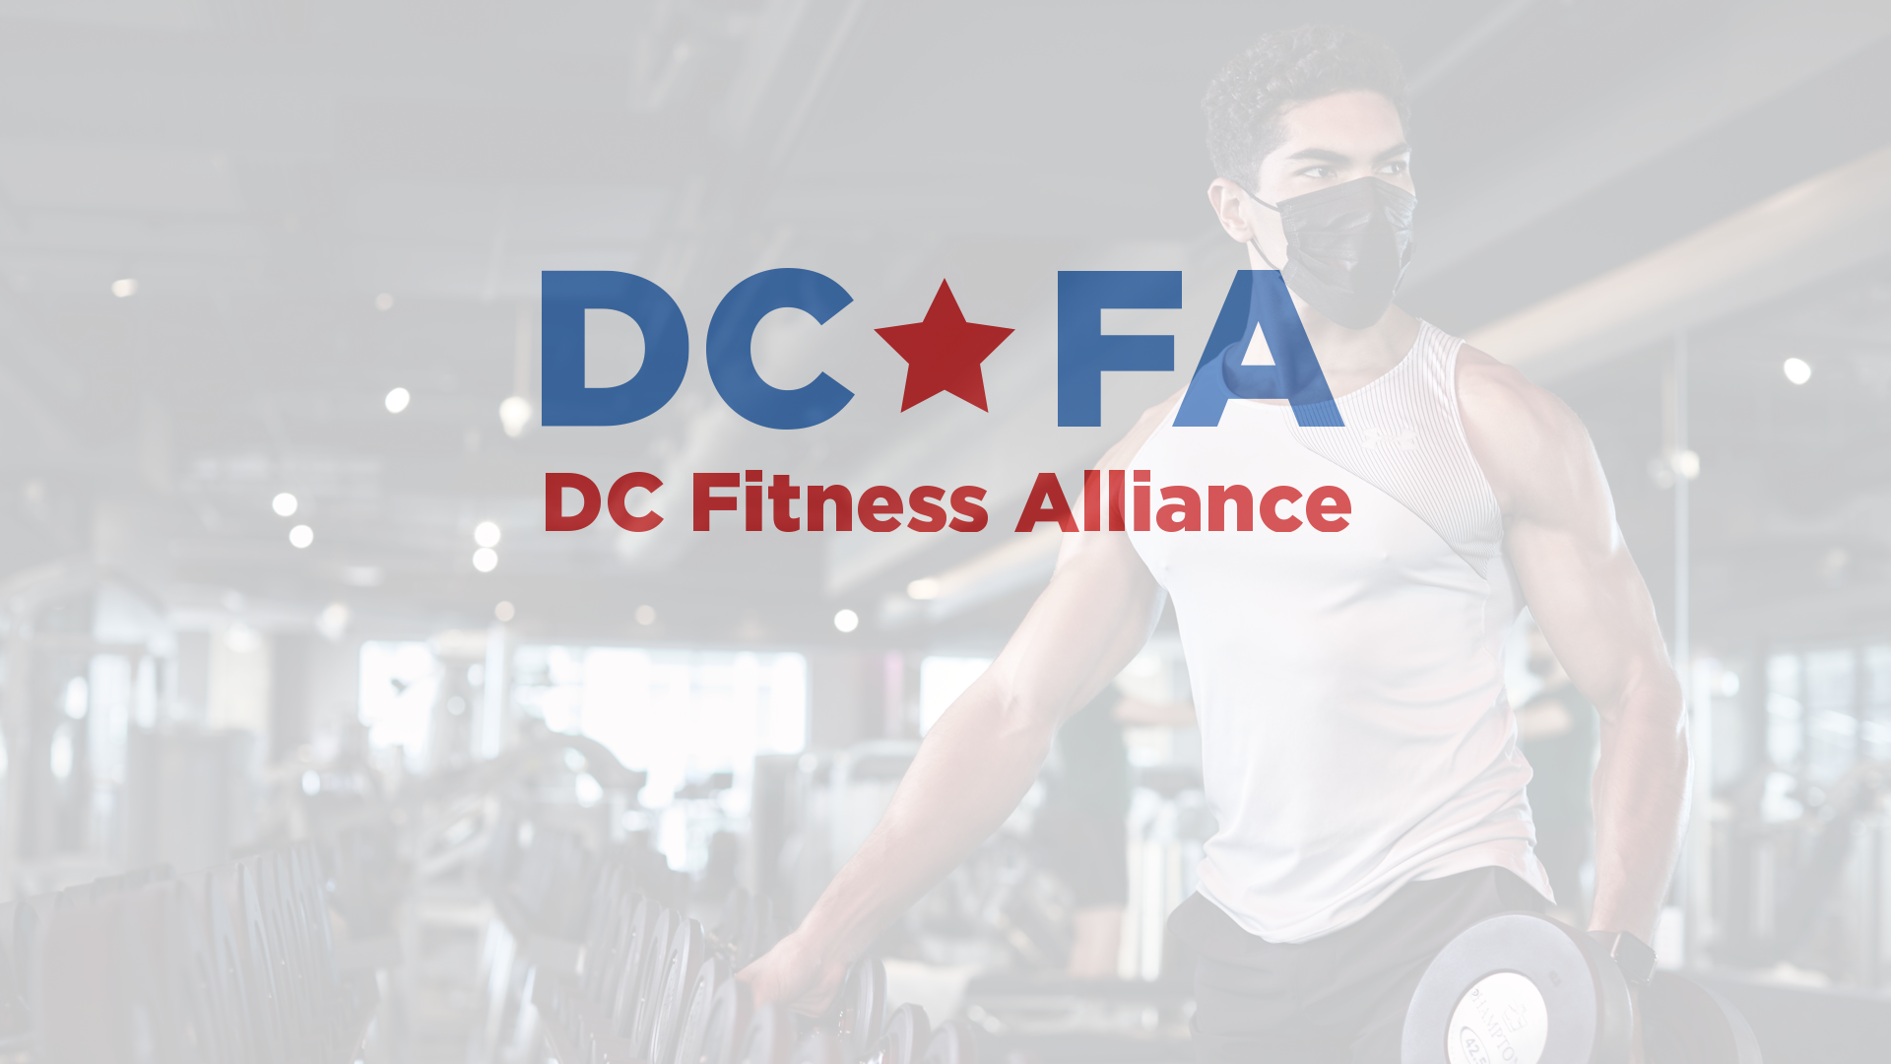
Our Brands
Balance Gym | Crunch Fitness | Elevate Interval Fitness | Golds Gym
Onelife Fitness | Sport & Health | VIDA Fitness | YMCA of Metropolitan Washington
DCFA Online Resources

Slide 2
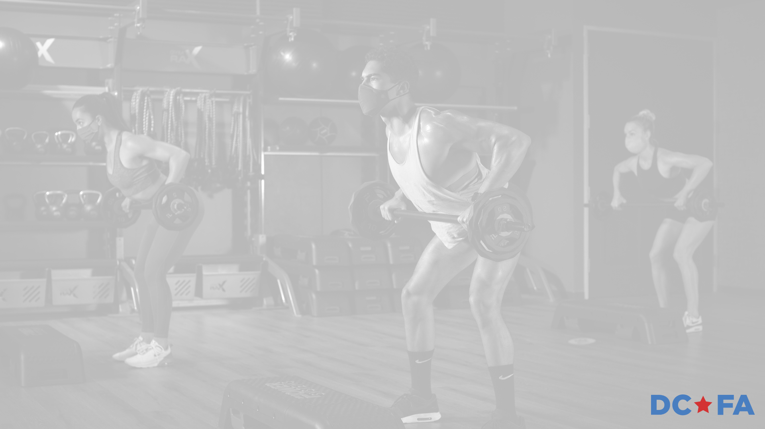
Agenda
  COVID-Safe Commitments
  Safety Strategies & Results
  Industry Research & Data
  Fitness is a Critical Service
  DC CAN Partnership

Slide 3
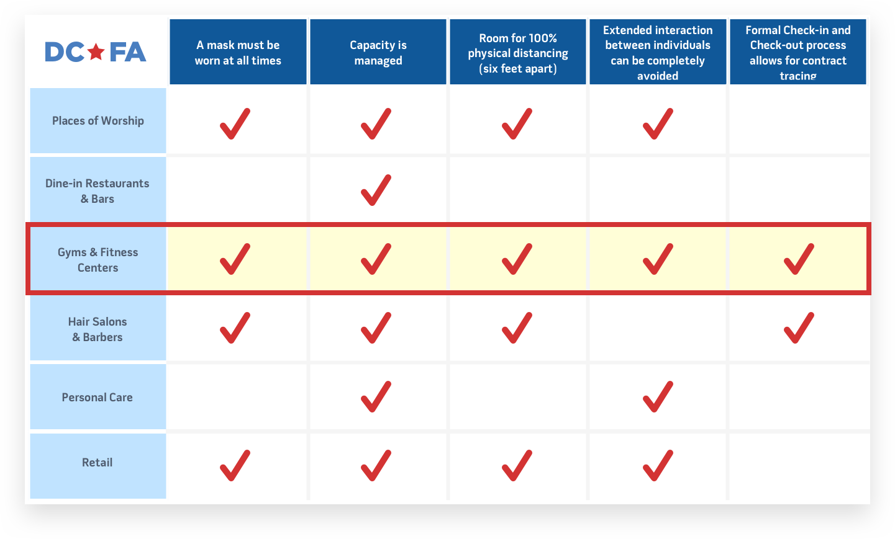
Fitness Facilities Offer More COVID-Safe Commitments

Slide 4
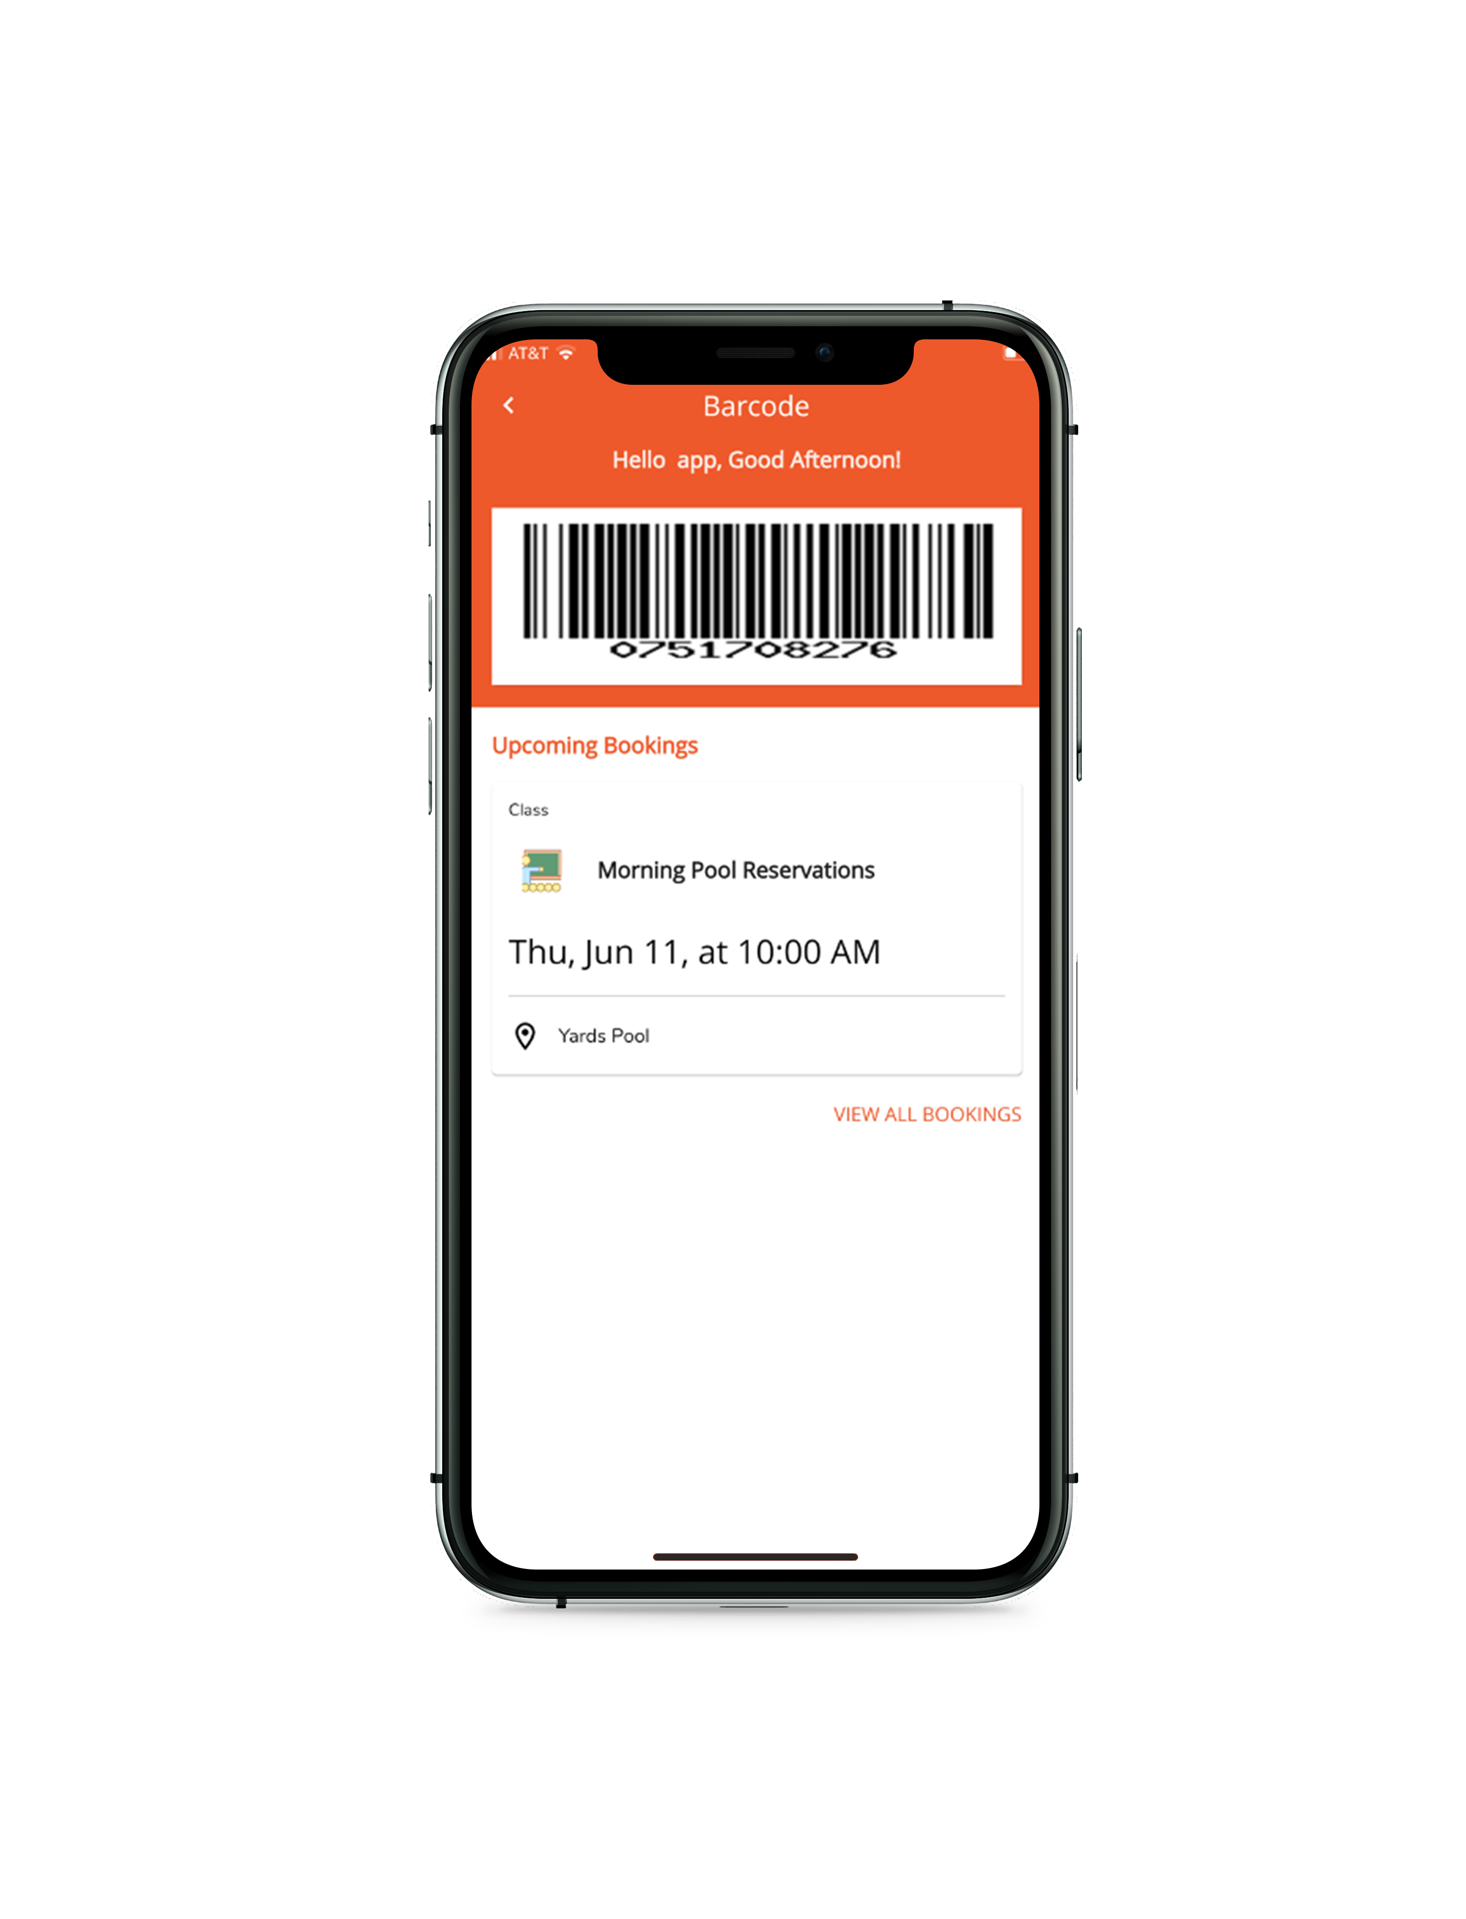
Contact Tracing
The Fitness Industry manages contact tracing through detailed check-in procedures and online reservation systems:
Control capacity to ensure proper social distancing
Touchless, timestamped check-in with time limits
Eliminate lines, wait times, and unnecessary exposure
Verify contact information

Slide 5

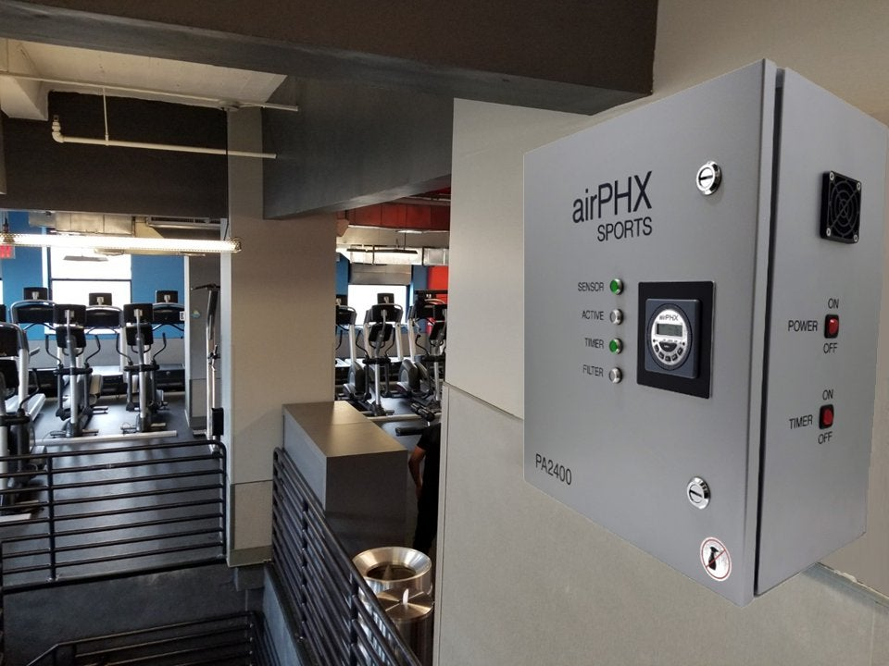
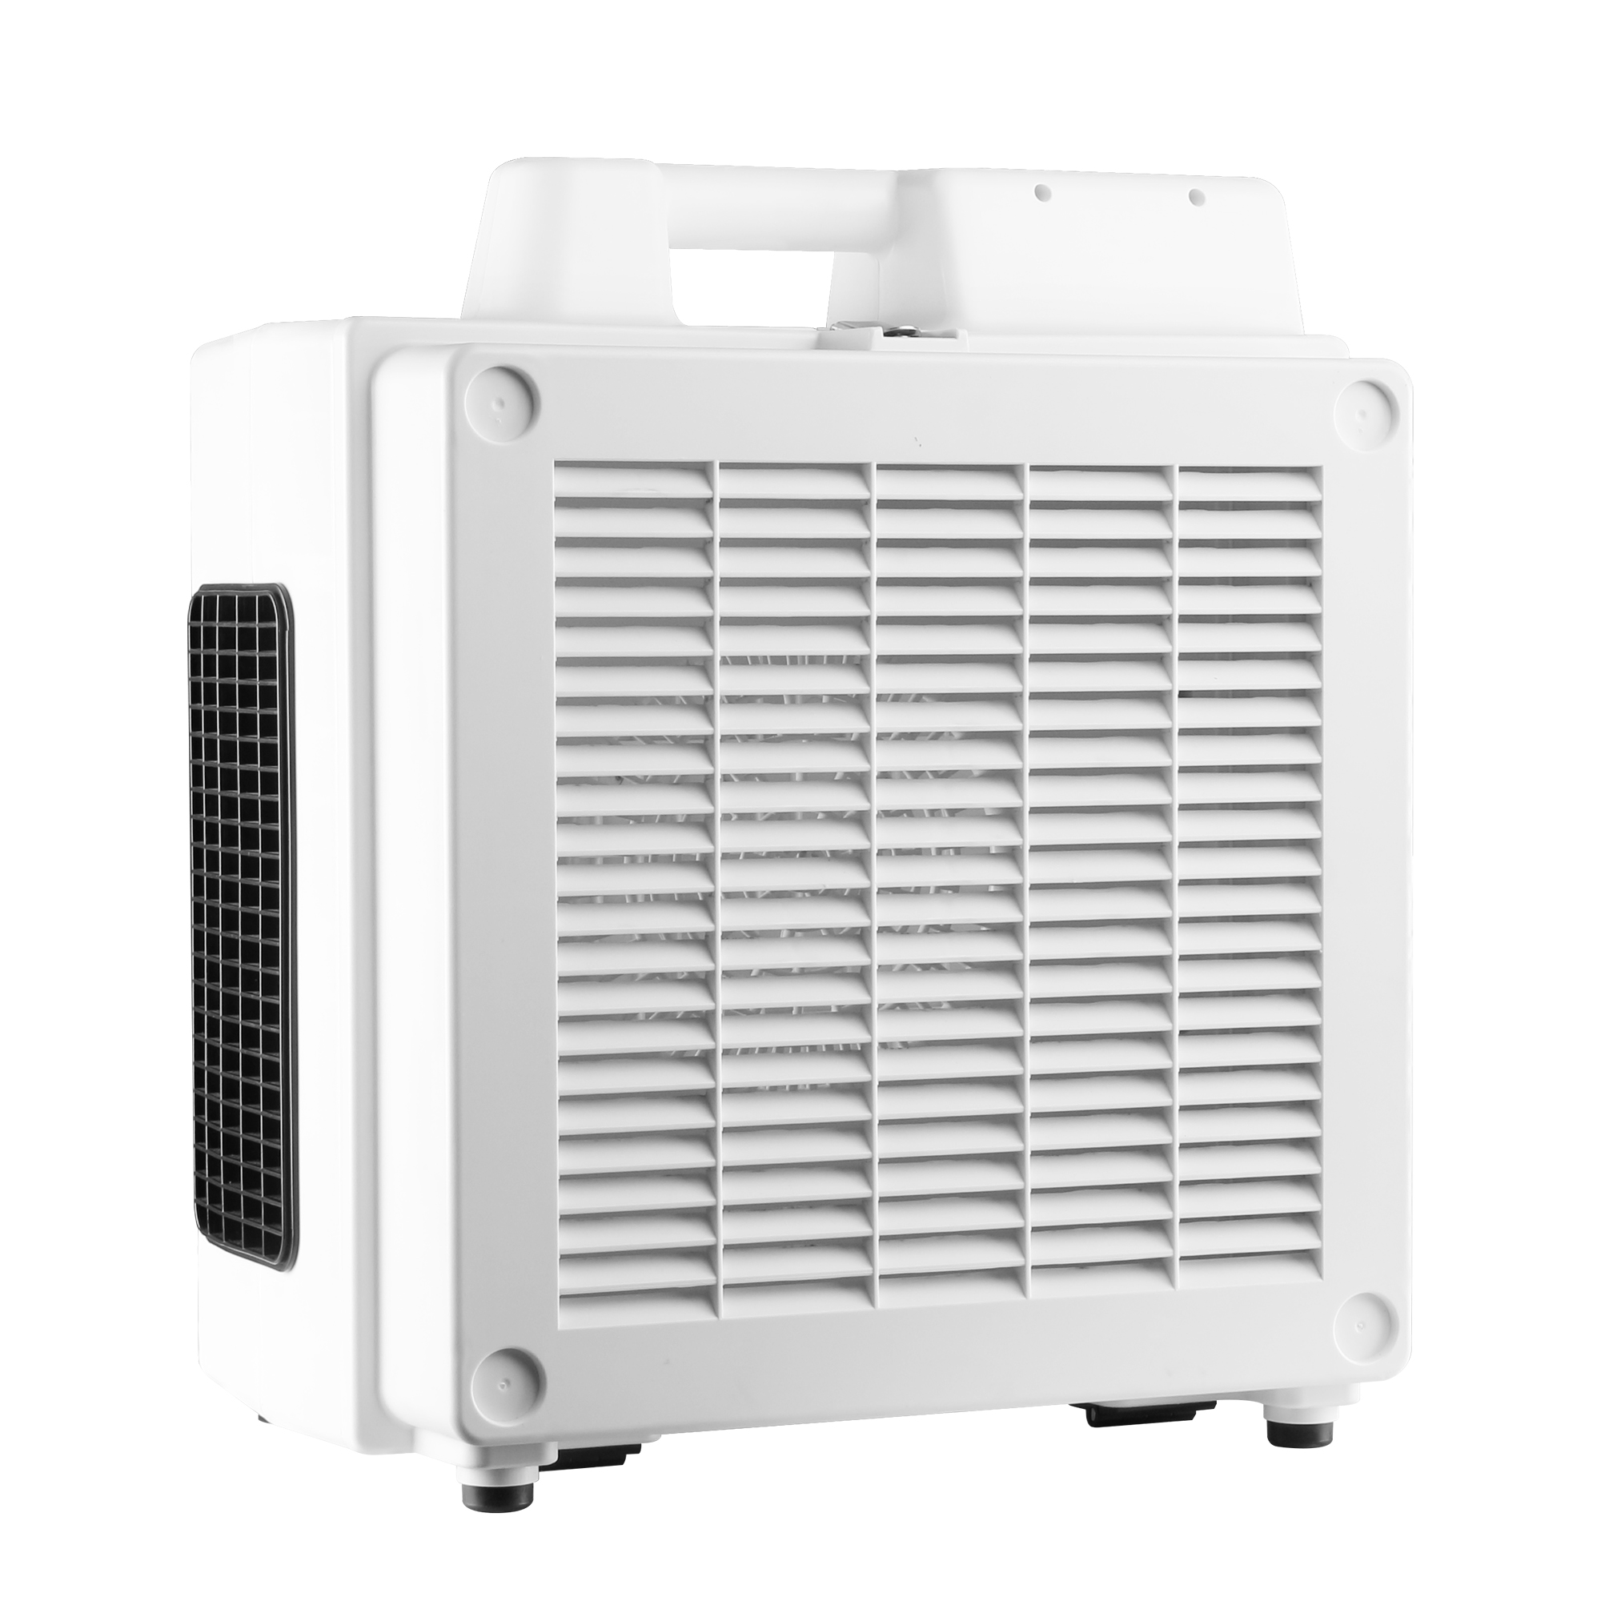
The Big 3 in combatting COVID-19
Facemasks: everyone who enters a fitness facility wears a mask the entire time they are in the facility.
Surface Disinfection: members utilize CDC recommended disinfectant spray throughout their workout. Employees disinfect all surfaces throughout the day with Electrostatic Sprayers.
Ventilation: fitness facilities have strict ASHRAE requirements for Air Changes per Hour (ACH). Our HVAC systems turn the air over 20-30x/hour. We’ve also installed portable air purifiers with HEPA filters.

Slide 6

Results
DCFA facilities have logged 371,676 member check-ins since the Phase 2 reopening in June 2020 with only 8 reported cases (0.0022%).
None of the reported cases were contact traced back to the fitness facility and there was no additional spread.

Slide 7
Fitness Industry Key Facts & Data
An industry survey conducted by MXM, consisting of 2,877 fitness facilities, reported 1,155 COVID-19 cases out of 49.4 million check-ins.
Out of 49.4 Million check-ins the percent of COVID-19 Cases is:
0.002%
or… statistically irrelevant!

Slide 8
Fitness Industry Key Facts & Data Continued
OUTBREAK SETTING | NUMBER OF OUTBREAKS | CASES
Automotive | 14 | 62
Bar | 43 | 484
Camp | 2 | 10
Casino | 10 | 227
Child Daycare | 31 | 113
Construction Site | 7 | 74
Food Processing | 33 | 875
Funeral | 3 | 6
Gym/Fitness Setting | 9 | 41
Industrial Setting | 72 | 493
Office Space | 23 | 102
Other Worksite | 40 | 202
Recreation | 6 | 26
Religious Services/Event | 45 | 233
Restaurant | 53 | 230
Retail Setting | 40 | 141
Ship/Boat | 3 | 9
Social Event | 8 | 64
Wedding | 9 | 57
Grand Total | 451 | 3449
Louisiana tracks data on COVID-19 cases by physical setting.
Gym/Fitness ranked 15th out of 19 in volume of COVID-19 cases.
Additional data available on the DCFA website

Slide 9
Why are Fitness Facilities Critical?
Fitness Facilities provide community and social encouragement. District residents are far more likely to exercise consistently with us than outdoors or at home. We safely provide an alternative outlet to the social gatherings that have caused a recent increase in cases.
The Chicago Medical Society has endorsed fitness facilities in a recent letter to Mayor Lightfoot
Why not just go outside?
  Temperatures are dropping as we enter the Winter months
  Many people are not comfortable exercising outdoors during their preferred times (mornings before sunrise and evenings after sunset) due to perceived safety, visibility, and park access
Why not just exercise at home?
  Residential space limitations
  Availability and affordability of fitness equipment and technology

Slide 10
Fitness Facilities provide Critical Services
The Health Care Continuum
Fitness Facilities serve a critical role in preventing obesity, diabetes, and high blood pressure. Regular exercise boosts the immune system, improves mental health, alleviates stress, and facilitates a restful night’s sleep.
Many Americans are living a highly sedentary lifestyle and largely confined to their homes. Depression, substance abuse, weight gain, domestic abuse, and suicide are all on the rise as a result of the pandemic. People are consuming excessive amounts of processed foods, sugar, sodium, saturated fat, and alcohol.
Those with obesity are at a greatly increased risk for hospitalization (113%) as a result of the coronavirus, are more likely to be admitted to the ICU (74%), and have a higher risk of death (48%).
Fitness Facilities provide a solution. We directly combat these pandemic ripple effects through physical activity and healthy food choices. District residents have always embraced fitness as part of their identity, and we are frequently recognized as one of America’s Fittest Cities.
See a full list of benefits in the Why Fitness is Essential article on the Resources page of our website

Slide 11


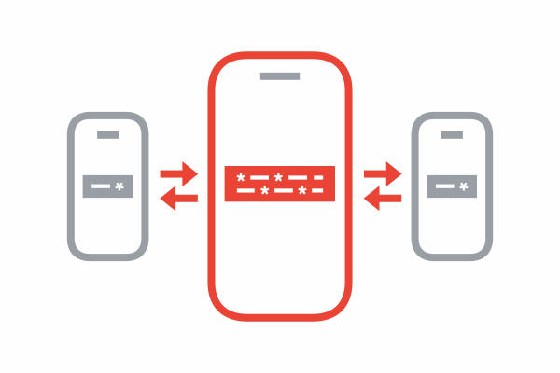


DC COVID Alert Notice (DC CAN)
The DCFA wants to partner with the Mayor’s Office and DC Health on a public messaging campaign:
Enroll in COVID-19 Exposure Notifications through DC CAN
Promote the importance of exercise for boosting the immune system, alleviating stress, and facilitating a restful night’s sleep.
Inform DC Residents on the best practices to exercise safely indoors and outdoors
Incorporate into the DC CAN Supporter Toolkit

